Slide 1
Hydration Recreation!
My Terminal Add

Slide 2
Game play:

Slide 4
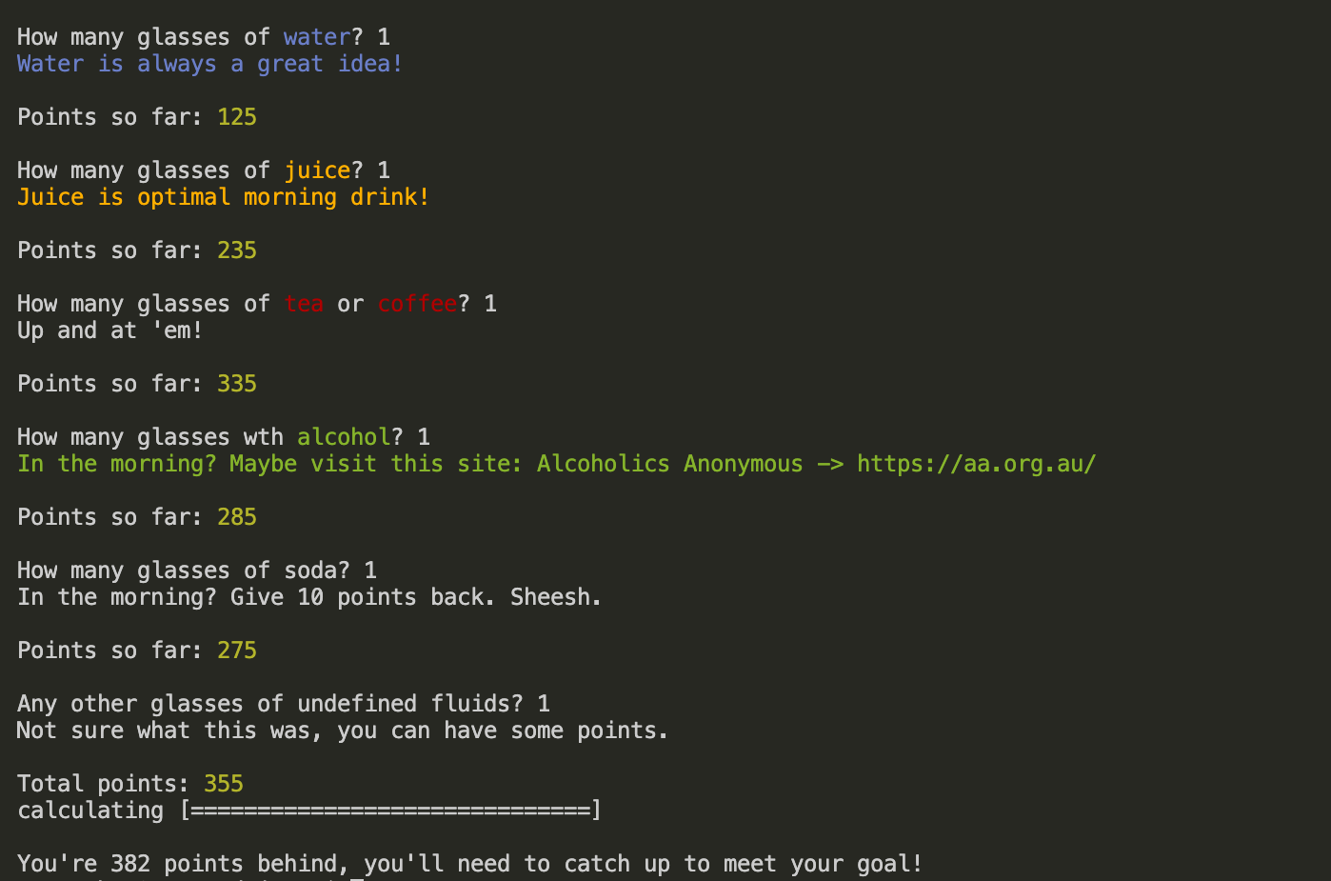

Slide 5
Readability:

Slide 7
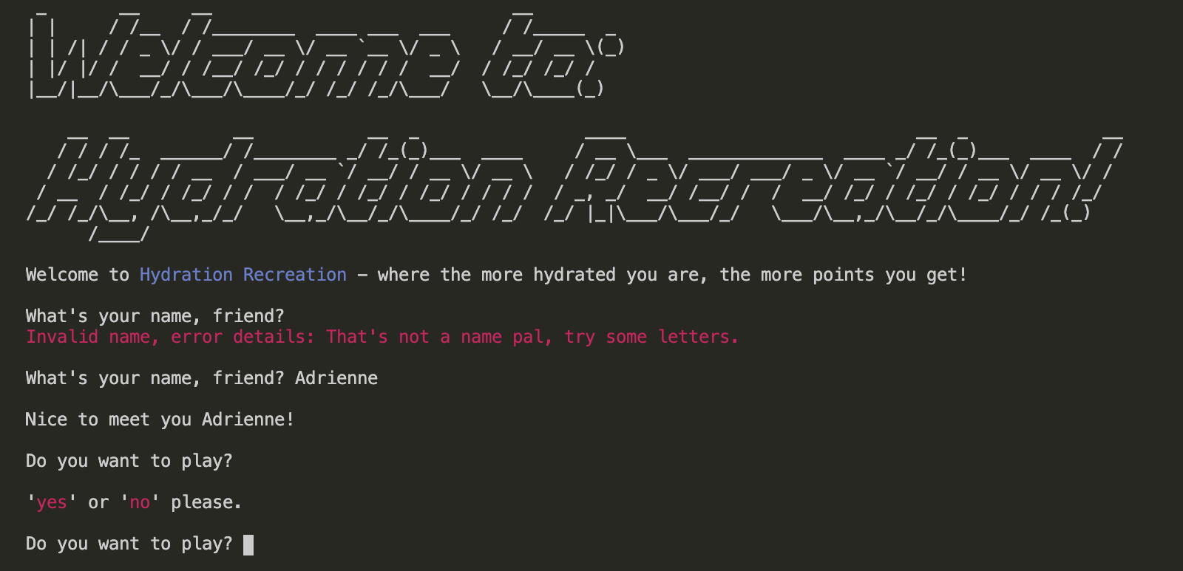
Input validation:

Slide 8
Input validation:

Slide 9
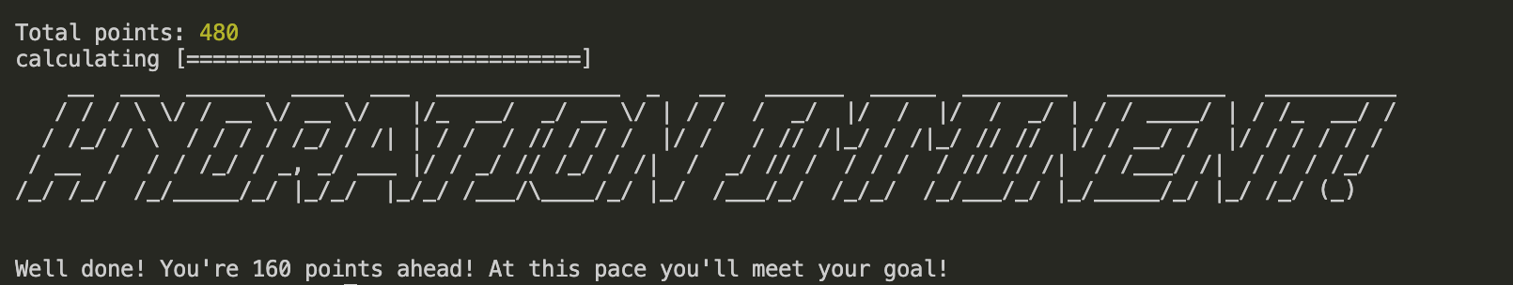
Calculation and Evaluation:

